Slide 1


Invoice Automation Using xlwings
By
Gj.RAJALAKSHMI
IMMEK SOFTECH ACADEMY

Slide 2
Project Overview
Automating invoice creation using Python and Excel (xlwings)
Reduce manual effort
Improves accuracy and speed
Enable bulk invoice processing

Slide 3
Business Problem
ERP (SAP HANA) downtime risk
Manual report dependency
Delay in accessing invoice data
Risk to operations / decision-making
Invoice data unavailable during ERP downtime
'Manual extraction is time-consuming and error-prone

Slide 4
Objective
Aimed to achieve
Ensure offline availability of invoice reports
Automate report generation
Improve reliability and speed

Slide 5
What is xlwings?
Python library to automate Excel
Works with Microsoft Excel
Allows reading/writing Excel data
Can trigger Python scripts from Excel
Integrate between excel and python

Slide 6
Tools & Technologies
Python
xlwings
Excel
Jupiter Notebook

Slide 7
Existing (Manual) Process
Open Excel template
Enter customer details manually
Calculate totals
Save each invoice individually
Repeat for multiple customers

Slide 8
Proposed Automated Solution
Input data stored in Excel template
Python script processes data
Automatically fills invoice template and invoice generated automatically
Saves invoices in excel with named output folder

Slide 9
Key Features
Bulk invoice generation
Automated Data Processing
Offline accessibility
Scalable for future reports
Template-based design
Error reduction
Fast Excel report generation

Slide 10
Flowchart of Invoice Automation
Start
Start
Invoice Template/Input
Trigger Python Script (xlwings)
Process & Validate Data
Generate Invoice
Save as Excel

Slide 11
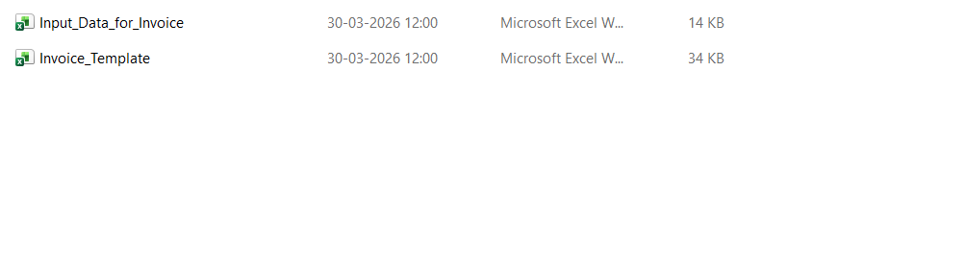
Input data/ Invoice Template
Input Data for Invoice:

Slide 12
Demo of Input
Input Data For Invoice

Slide 13
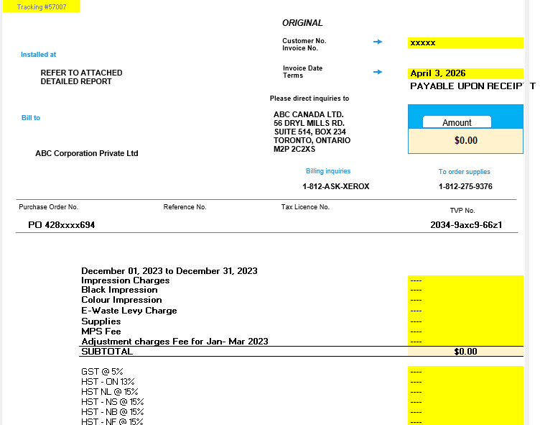
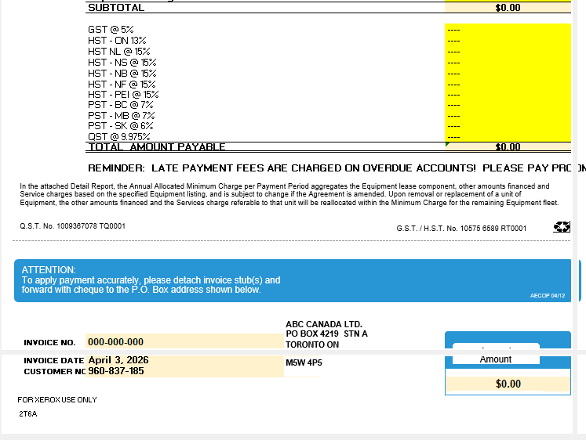
Invoice template Need to filled Automatically
Invoice Template: The highlighted fields are need to be filled automatically using xlwings.

Slide 14
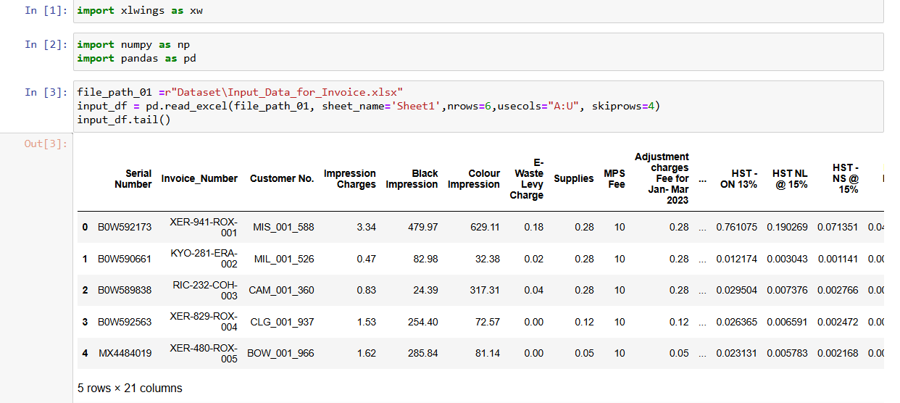
Code Snippet
Input Data: The input data is read by using the below python code

Slide 15
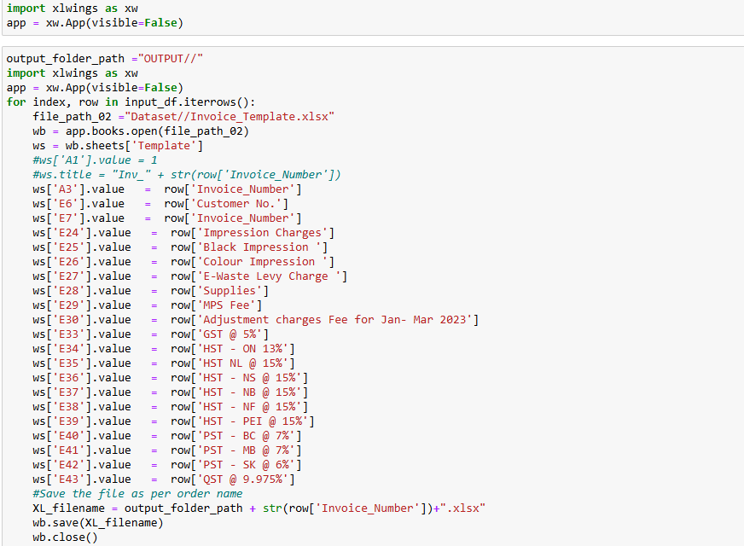
Code Snippet
For the given invoice template,datasets are iterated (input data) and each fields are filled accordingly using the below code snippet and saved in the output folder with separate invoice number.

Slide 16
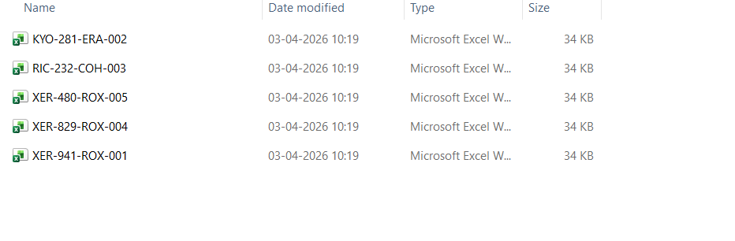
Output
Output folder: The below five invoices are generated automatically and saved in the output folder as below.

Slide 17
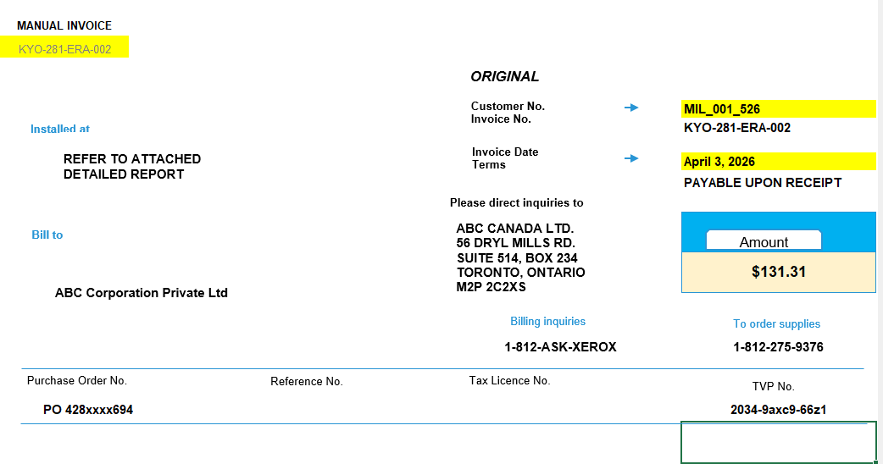
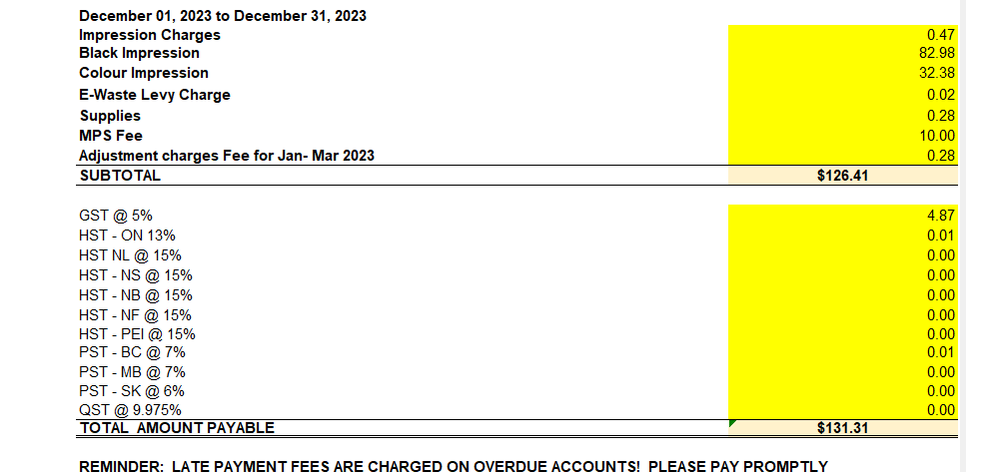
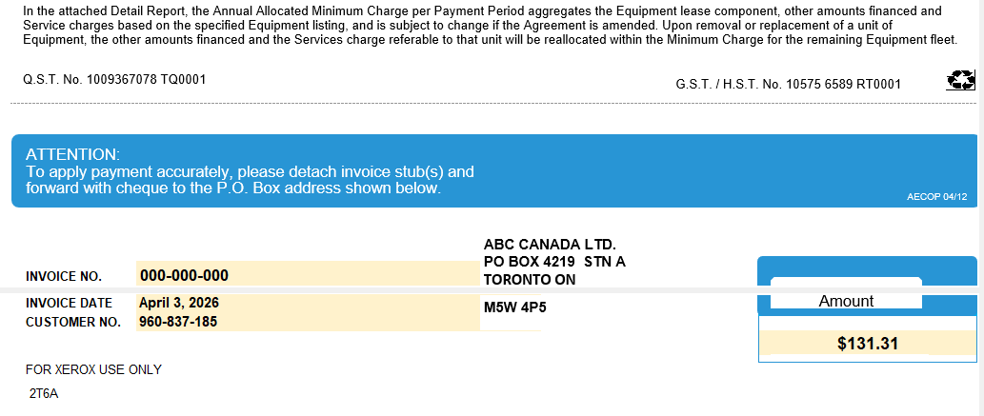
Automated Invoice Generated using xlwings
Below is the sample output generated:

Slide 18
Value adds to Business
Saves time ( 2 to 3 hours/day)
Reduces manual errors
Ensures continuity during ERP downtime
Reliable backup system
Scalable solution
Faster decision making and easy to maintain
Reusable for other reports

Slide 19
Conclusion
This solution ensures uninterrupted access to critical invoice data and improves operational efficiency.
xlwings helps bridge between Python and Excel for real-world automation projects
Automation improves efficiency
xlwings is powerful for Excel-based workflows
Suitable for Finance and Operations teams

Slide 20

Thank You!

